Slide 1
A Multivocal Literature Review of Current Tools for Increasing the Degree of Automation in the Development of Secure and Privacy Compliant Applications
John Nguyen, 10. August 2020, Kick-off presentation

Slide 2
Outline
  Motivation and Background
  Research Goal and Methodology
  Initial Results
  Timeline

Slide 3
Motivation and Background
Numbers of record lost in Mio.
Name of the company
Challenge: More and more data is being stored and processed → Volume of stolen data increases
Issues:
Violation of security principles
  Least privilege
  Defense in depth
  Minimum exposure
Lack of security training
  Security awareness [5]
Weak encryption
  MD5 encryption used by Yahoo [6]
Conflict of interests between stakeholders
  Focus on functional requirements
  Developers ↔ Architects ↔ Management
Note: Worldwide; April 2020; based on number of records lost
Further information regarding this statistic can be found on page 8.
Source(s): Information is Beautiful; Various sources (VizSweet); Thomson Reuters; ID 290525

Slide 4
Motivation and Background (cont’d)
Based on Data Breach Investigations Report. (2020). In Verizon. https://enterprise.verizon.com/resources/reports/2020-data-breach-investigations-report.pdf%0Ahttp://bfy.tw/HJvH. Summary

Slide 5
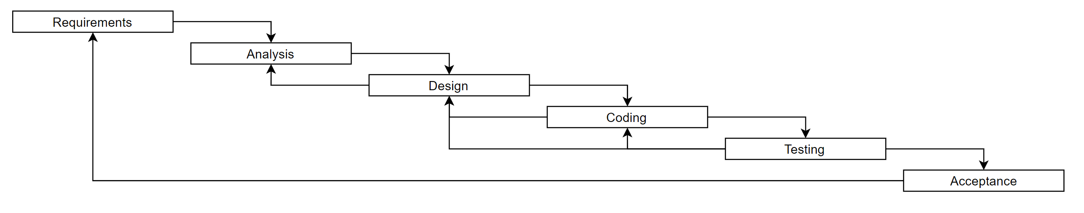
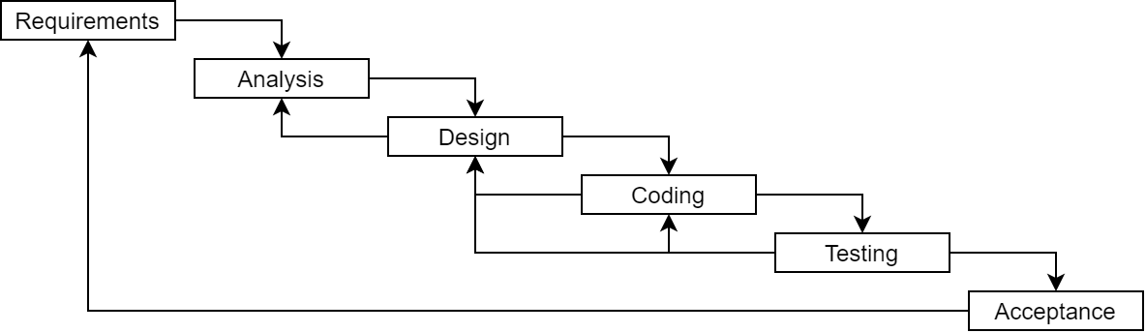
Motivation and Background (cont’d)
Not so different after all
Waterfall
Agile
DevOps
DevOps
At Scale
Time

Slide 6
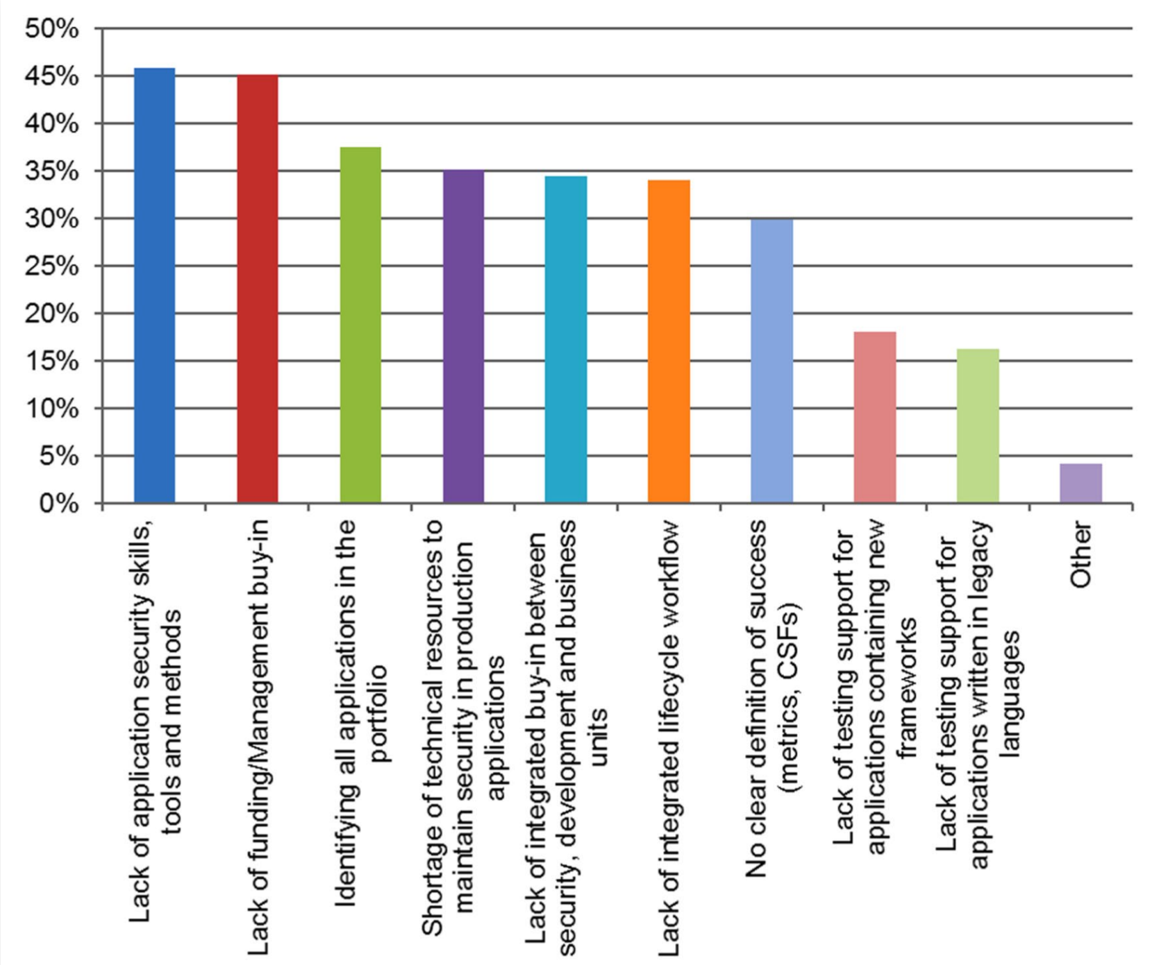
Motivation and Background (cont’d)
Need for Security and Privacy Automation Tools
Challenges of agile software development
Neglection of non-functional requirements
Rapid pace of development and deployment
Knowledge boundaries (e.g. documentation) [3][4]
Benefits
Improving scalability
Reducing human error [1]
Checking continuously instead of an interval basis [2]
Avoid cost explosion due fixing at implementation stage [9]
Lack of security experts [10]
Parallel testing [13]
Filkins, B., Bird, J., & Kim, F. (2014). Survey on Application Security Programs and Practices. SANS Technology Institute. Figure 17. Implementation Challenges.

Slide 7
Security and Privacy Automation is not a Silver Bullet
Wide range of skills required
Integration of new tools
  Conflict with legacy systems
  Conflict with an established mindset [7]
Faded boundaries between the security team and developers [8]
Additional cost
  Need for additional education and improved culture → tool
  Acquiring new technologies (tools)
Cross-team cooperation necessary [1]
Isolated tools to solve specific problems [11]
→ we look into centralized solutions
Security tools
Knowledge: security training
Culture: caring about security
Continuously tracking security measurements
Based on [12]. DevSecOps Pyramid

Slide 8
Outline
  Motivation and Background
  Research Goal and Methodology
    Methodology
    Research Questions
    Search Strategy
  Initial Results
  Timeline

Slide 9
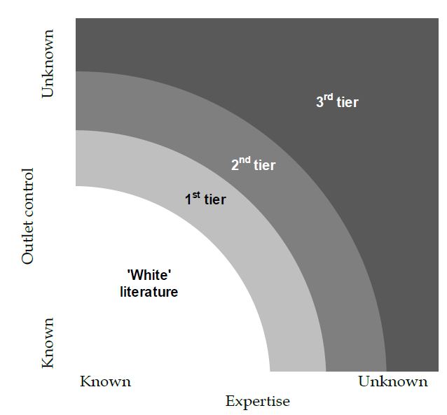
Methodology
Multivocal Literature Review:
Form of Systematic Literature Review
Covers both the state-of-the-art and –practice
Inclusion of a large body of grey literature
Benefits:
Certain evidence is often based on experience and opinion
Inclusion of real-world needs in industrial settings
May avoid publication bias
Challenges:
Quality assessment
Large volumes of data → need for a termination criteria
Bias and lack of quality [14]
Adams, R. J., Smart, P., & Huff, A. S. (2017). Shades of grey: guidelines for working with the grey literature in systematic reviews for management and organizational studies. International Journal of Management Reviews, 19(4), 432–454. Figure 1. Shades of grey literatures

Slide 10
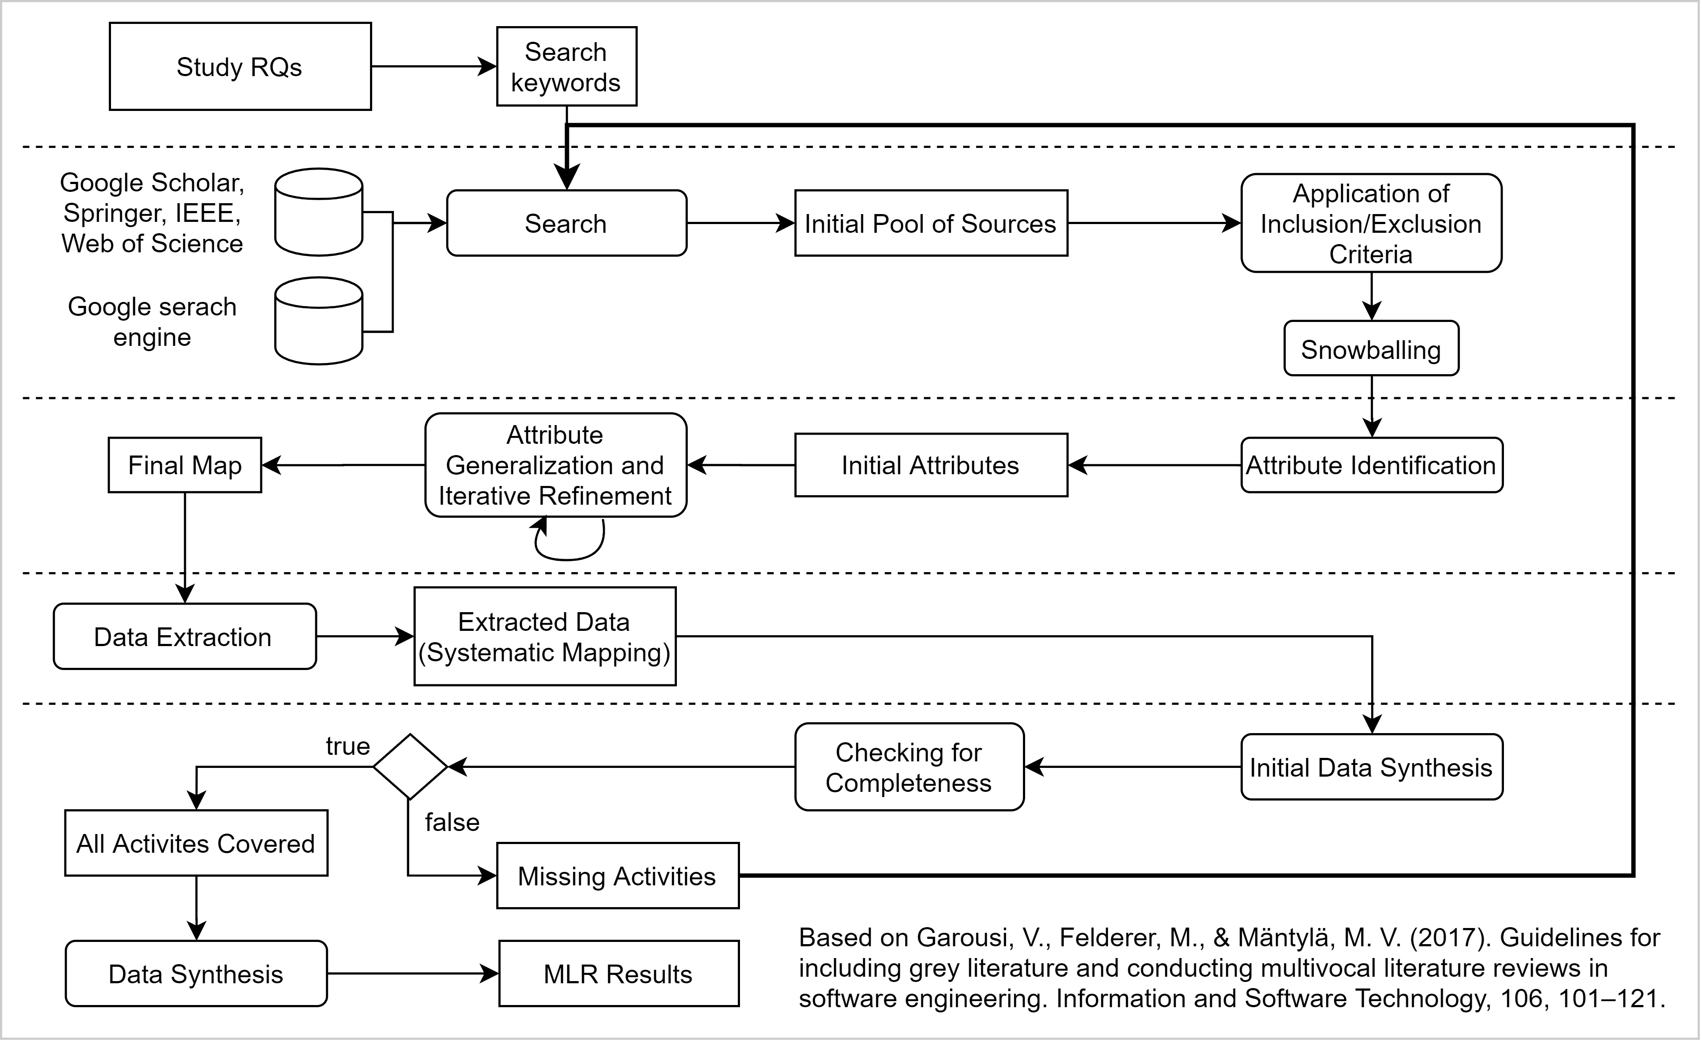
Methodology (cont’d)

Slide 11
Research Questions
Research Questions:
RQ1: What challenges can automation tools address when developing security and privacy compliant applications?
RQ2: How can the identified technologies and tools be classified?
RQ3: To what extent can security and privacy activities be automated with current available automation tools?

Slide 12
Search Strategy
Search String:
SLR: (secur* OR priva* OR protect*) AND ("software development" OR "software engineering") AND (tool* OR control*) AND (automat* OR "continuous") AND ("DevOps" OR "agile")
GLR: tool AND (security OR privacy) AND automation AND (DevOps OR Agile)
Inclusion criteria for SLR:
Written in English and full test accessible
Accessible with TUM rights or freely accessible
Online available
Paper must discuss security or privacy compliance automation
Paper must include any kind of tool, framework demonstration/implementation, prototype or similar to the support software development lifecycle
Within the Software Engineering domain
Paper must be published in a journal or conference paper (workshops and tutorials are excluded)
Published between 2015-2020 (initial search)
Exclusion criteria for SLR:
Duplicates or repeated studies
Lack of relevance for RQs
Algorithms and concepts

Slide 13
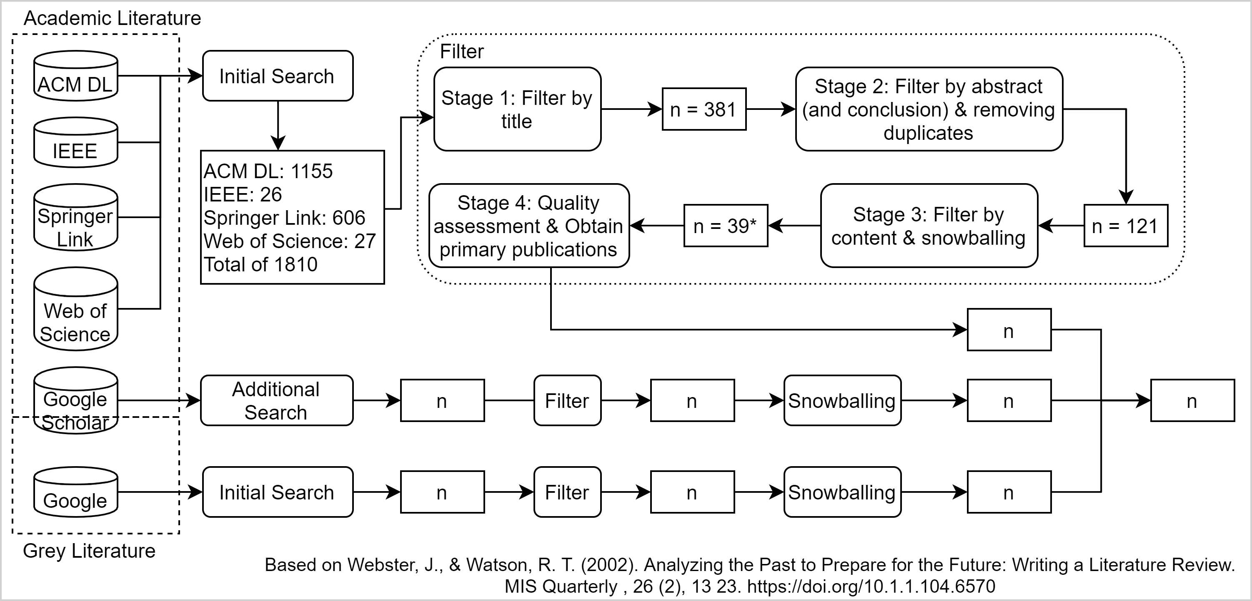
Search Strategy (cont’d)

Slide 14
Outline
  Motivation and Background
  Research Goal and Methodology
  Initial Results
  Timeline

Slide 15
Initial Results
Development
Centralized/ Cross-Tool | supporting/ modelling | testing |  | scanning | monitoring & alerting | tracking | logging/documentation | review | Code enhancing
 |  | code | optimization
Infrastructure |  |  |  | Governance
testing | infrastructure configuration | scanning | monitoring | vulnerability management | training/awareness
Tools | Source | Description | Taxonomy
Sonarqube | https://www.sonarqube.org/ | Static code analysis | Development – testing – code
Splunk | https://www.splunk.com/ | Logging | Development – monitoring
NMAP | https://nmap.org/ | Network scanning tool | Infrastructure – scanning
Conpan | https://github.com/neglectos/ConPan | Analysis of packages in container | Infrastructure – scanning
Data-driven Security Game (DdSG) | https://github.com/dagerikhl/ddsg | Improve security awareness | Governance – training

Slide 16
Outline
  Motivation and Background
  Research Goal and Methodology
  Initial Results
  Timeline

Slide 17
Schedule
Thesis Kickoff
Submission
Thesis completion
15 Jun
29 Oct
15 Nov
2020
Jun
Jul
Aug
Sep
Oct
Nov
2020
Today
Preperation Phase
5 days
Research Phase
62 days
Writing Phase
50 days
Correction Phase
12 days
Buffer
13 days
28 Oct - 15 Nov

Slide 18
John Nguyen
17132
john.nguyen@tum.de

Slide 19
References
[1] Myrbakken, H., & Colomo-Palacios, R. (2017). DevSecOps: A Multivocal Literature Review. https://doi.org/10.1007/978-3-319-67383-7_2
[2] Phil, G. D. (2017). Compliance at Velocity within a DevOps Environment. In Muhammad Zaid Abrahams. University of Johannesburg.
[3] Ahmed, A. M. (2019). DevSecOps : Enabling Security by Design in Rapid Software Development.
[4] Uludag, Ö., Kleehaus, M., Caprano, C., & Matthes, F. (2018). Identifying and structuring challenges in large-scale agile development based on a structured literature review. Proceedings - 2018 IEEE 22nd International Enterprise Distributed Object Computing Conference, EDOC 2018, 191–197. https://doi.org/10.1109/EDOC.2018.00032
[5] Dr. Alexander Pretschner. (2020). Security Engineering. Security Principles. Retrieved June 6. 2020, from https://www.moodle.tum.de/pluginfile.php/2203779/mod_resource/content/1/Security_Engineering_110_Security_Principles.pdf
[6] Samuel Gibbs. (2016). Security experts: 'No one should have faith in Yahoo at this point’. Retrieved June 6, 2020, from https://www.theguardian.com/technology/2016/dec/15/security-experts-yahoo-hack
[7] Meera Rao. (2018). The challenges of shifting to DevSecOps. https://www.itproportal.com/features/the-challenges-of-shifting-to-devsecops/
[8] Isaac Eldridge. (2018). SecDevOps: Injecting Security Into DevOps Processes. Retrieved June 6. 2020, from https://blog.newrelic.com/technology/what-is-secdevops/
[9] Center, N. J. S. (2010). Error cost escalation through the project life cycle. Source of Acquisition NASA Johnson Space Center.
[10] Scandariato, R., Horkhoff, J., & Feldt, R. (2018). Generative Secure Design, Defined. Proceedings of the 40th International Conference on Software Engineering: New Ideas and Emerging Results, 1–4. https://doi.org/10.1145/3183399.3183400
[11] Islam, C., Babar, M. A., & Nepal, S. (2019). A Multi-Vocal Review of Security Orchestration. ACM Comput. Surv., 52(2). https://doi.org/10.1145/3305268
[12] Tomas, N., Li, J., & Huang, H. (2019). An Empirical Study on Culture, Automation, Measurement, and Sharing of DevSecOps. 2019 International Conference on Cyber Security and Protection of Digital Services (Cyber Security), 1–8. https://doi.org/10.1109/CyberSecPODS.2019.8884935
[13] Vila, E., Novakova, G., & Todorova, D. (2017). Automation Testing Framework for Web Applications with Selenium WebDriver: Opportunities and Threats. Proceedings of the International Conference on Advances in Image Processing, 144–150. https://doi.org/10.1145/3133264.3133300
[14] Garousi, V., Felderer, M., & Mäntylä, M. V. (2017). Guidelines for including grey literature and conducting multivocal literature reviews in software engineering. Information and Software Technology, 106, 101–121.

Slide 20
Backup Slides

Slide 21
Organization
About me
Thesis Organization
Name: John Nguyen (john.nguyen@tum.de)
Current Study: Information Systems (6th Semester)
Faculty: Informatics
Chair: Software Engineering for Business Information Systems (sebis)
Type: Bachelor Thesis
Supervisor: Prof. Dr. Florian Matthes
Advisor: Sascha Nägele
Timeframe: 15.06.2020 – 15.11.2020
Relevant Courses
SEBA Bachelor
Seminar: Trends der Wirtschaftsinformatik - Agilität und DevOps
Security Engineering (in progress)
iLab1

Slide 22
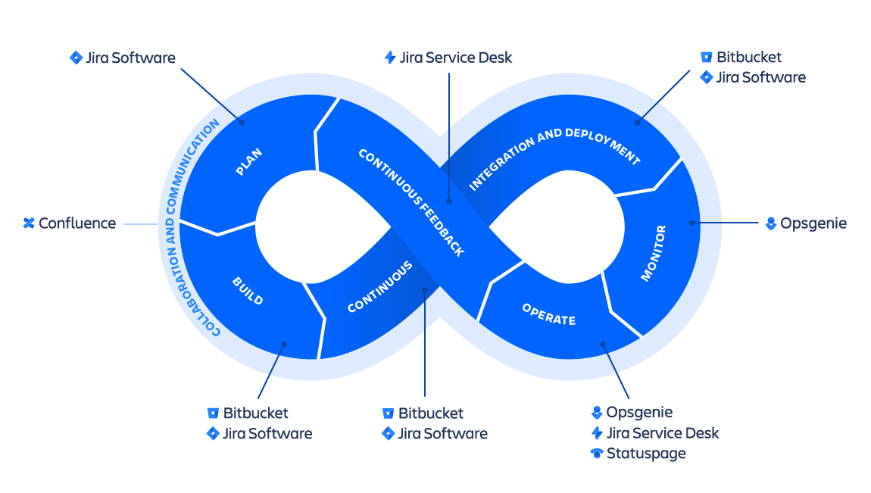
DevOps
https://wac-cdn.atlassian.com/dam/jcr:cd64c6de-34a3-436f-95e0-f8e600143dac/SWTMNG-263%20DevOps%20infinity%20wheel_CLOUD-PRODUCTS@2x.png?cdnVersion=1060 (Date: 06.06.2020)

Slide 23
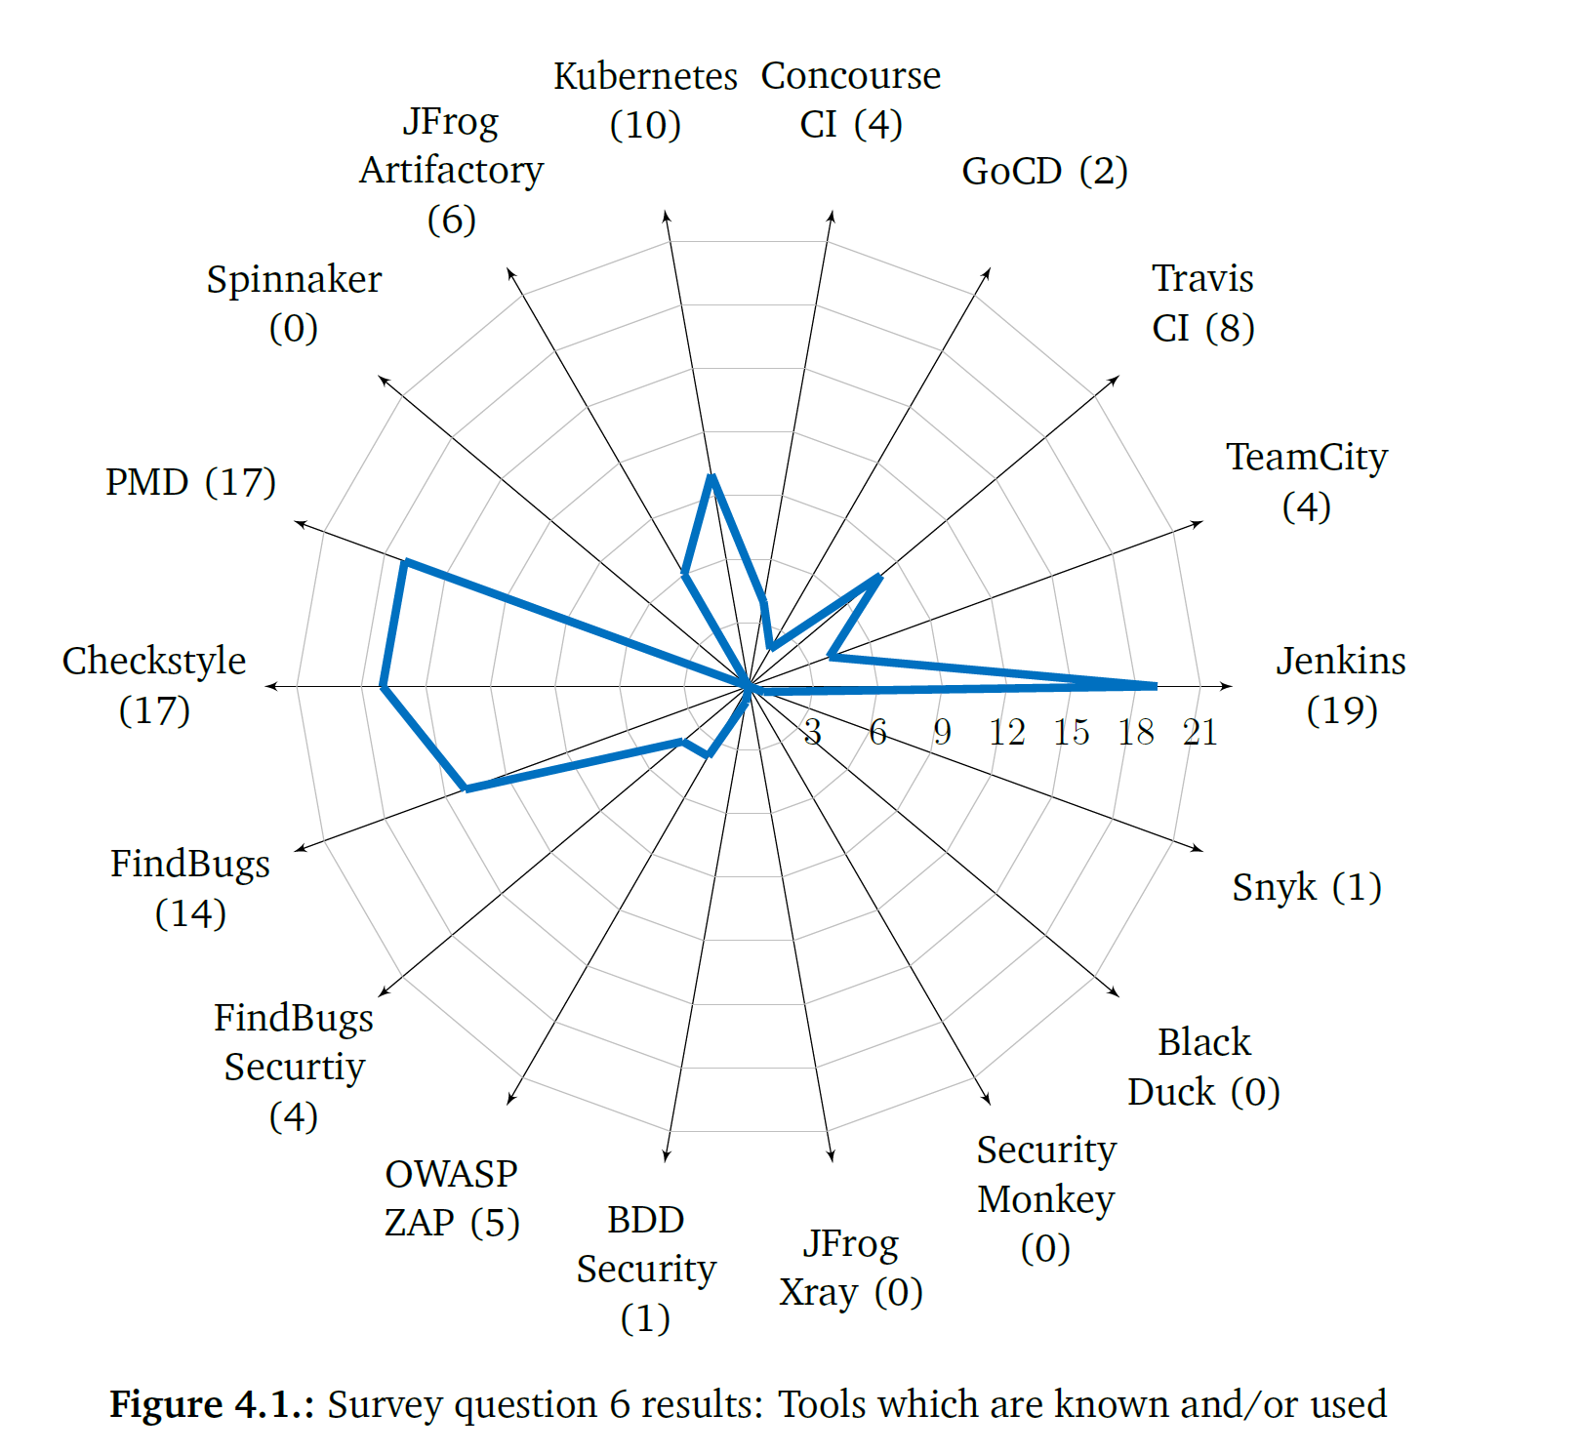
Knowledge of developers (2018)
100 employees of a selected industrial company
“Which tools do you know and/or use?
Response options:
(DevOps tools) Jenkins; Kubernetes; TeamCity; Spinnaker; Travis; GoCD; Concourse CI; JFrog Artifactory;
(static analysis tools) PMD; Checkstyle; FindBugs; FindBugs Security;
(security tools) OWASP ZAP; BDD Security; JFrog Xray; Security Monkey; Black Duck; Snyk”[1]
Paule, C. (2018). Securing DevOps: detection of vulnerabilities in CD pipelines Figure 4 p. 45 [1]

Slide 24
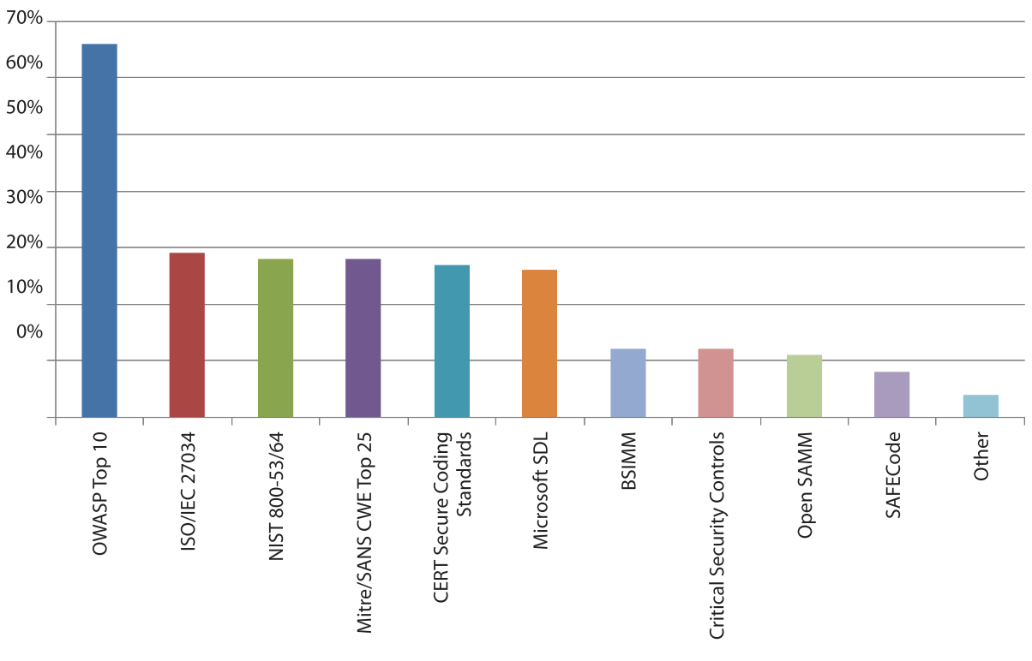
Security Standards and Modell (2016)
“What application security standards or models do you follow? Select all that apply.” [5]
435 respondents
OWASP Top 10 leading standard
Shackleford, D. (2016). A DevSecOps Playbook. SANS Institute InfoSec Reading Room. A DevSecOps Playbook Figure 2 p. 11 [5]

Slide 25
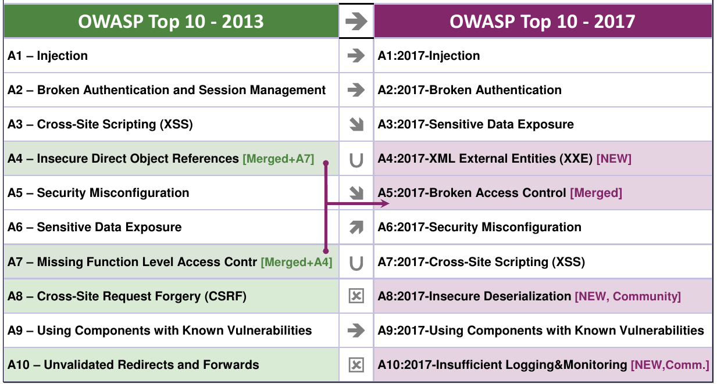
OWASP
International non-profit organization
Focus on web application security
Goal: Improve web application security
OWASP Top 10: represents top 10 risks (critical) [3]
https://www.heise.de/developer/imgs/06/2/3/6/0/4/7/9/2013-2017-50ed3603697420a0.png (Date: 04.06.2020]

Slide 26
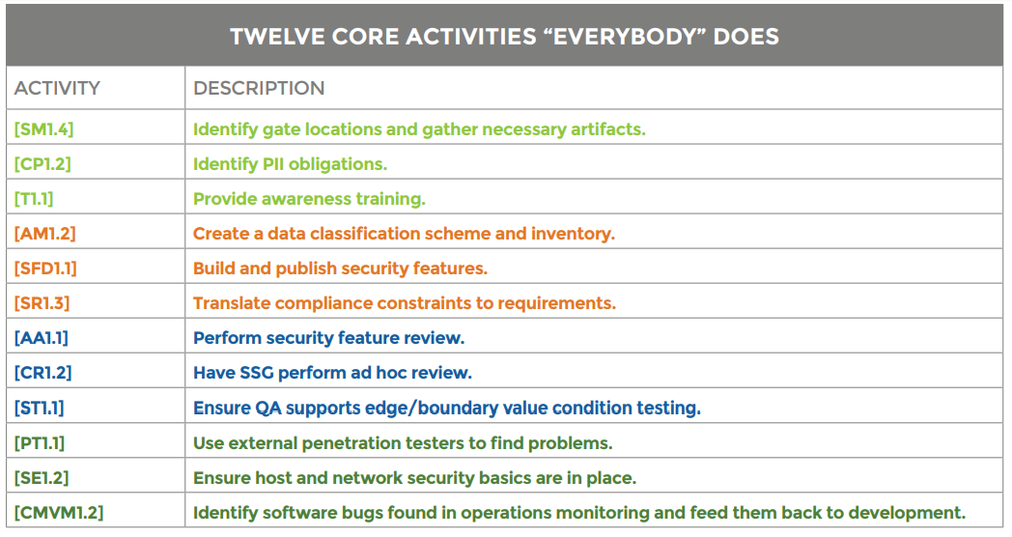
BSIMM
Software security framework
12 practices (in 4 domains) and 119 activities
Domains:
  Governance
    Strategy & Metrics
    Compliance & Policy
    Training
  Intelligence
    Attack Models
    Security Features & Design
    Standards & Requirements
  SSDL Touchpoints
    Architecture Analysis
    Code Review
    Security Testing
  Deployment
    Penetration Testing
    Software Environment
    Configuration Management & Vulnerability Management [4]
https://www.hack2secure.com/images/blog/BSIMM%20Skeleton%2002.png (13.06.2020)

Slide 27
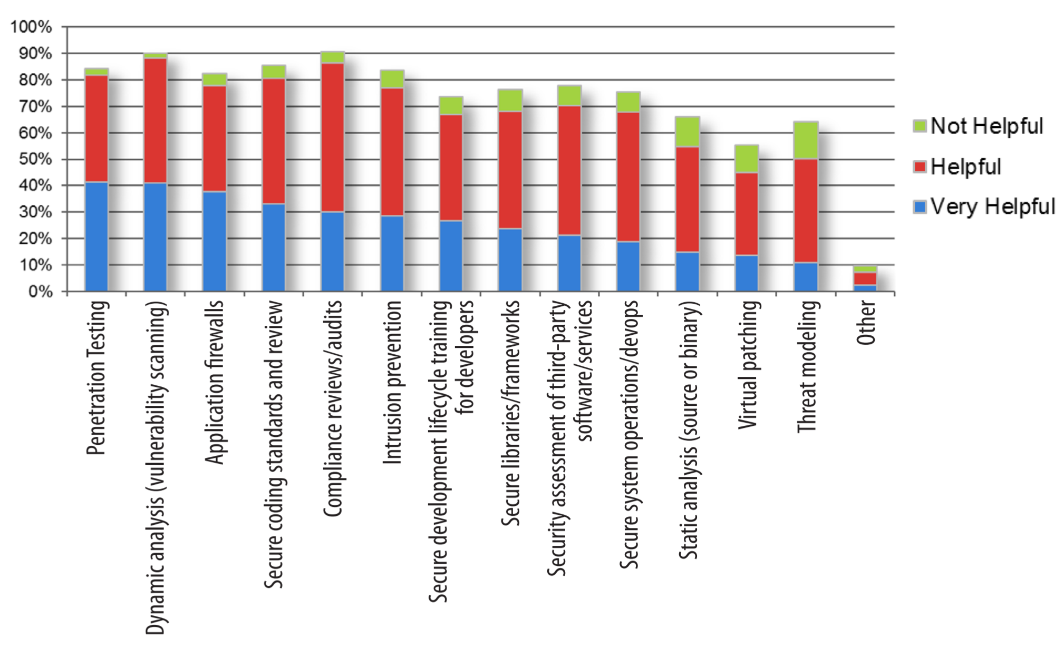
Security Practices with Rating
Filkins, B., Bird, J., & Kim, F. (2014). Survey on Application Security Programs and Practices. SANS Technology Institute. Figure 11. Effective Appsec Security Practices

Slide 28
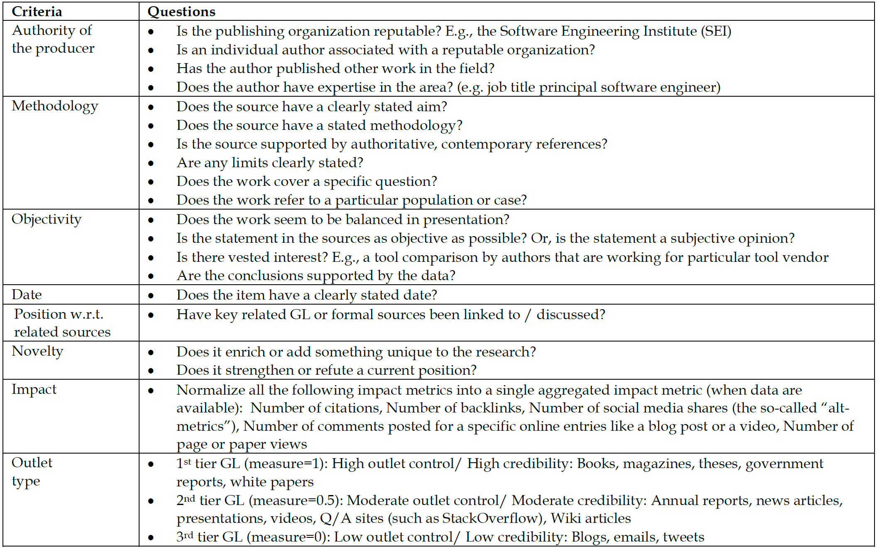
Quality Assessment in MLRs
Garousi, V., Felderer, M., & Mäntylä, M. V. (2017). Guidelines for including grey literature and conducting multivocal literature reviews in software engineering. Information and Software Technology, 106, 101–121. Table 7-Quality assessment checklist of grey literature for software engineering

Slide 29
References
[1] Paule, C. (2018). Securing DevOps: detection of vulnerabilities in CD pipelines [University of Stuttgart]. http://elib.uni-stuttgart.de/handle/11682/10046
[2] Myrbakken, H., & Colomo-Palacios, R. (2017). DevSecOps: A Multivocal Literature Review. https://doi.org/10.1007/978-3-319-67383-7_2
[3] What is OWASP? What Are The OWASP Top 10?. Retrieved June 6. 2020, from https://www.cloudflare.com/learning/security/threats/owasp-top-10/
[4] Hack2Secure. BSIMM Software Security Framework A Quick Walkthrough: Retrieved June 13. 2020, from https://www.hack2secure.com/blogs/BSIMM-Software-Security-Framework-A-Quick-Walkthrough
[5] Shackleford, D. (2016). A DevSecOps Playbook. SANS Institute InfoSec Reading Room. A DevSecOps Playbook. https://www.sans.org/reading-room/whitepapers/analyst/guarding-gateway-challenges-email-security-36597

